Slide 1

6th Grade Accelerated Math
Unit 8, Lesson 5 Surface Area of Rectangular Prisms and Pyramids Volume 2, pg. 24

Slide 2


Benchmark
MA.6.GR.2.4
Given a mathematical or real-world context, find the surface area of right rectangular prisms and right rectangular pyramids using the figure’s net.
volume 2, pg. 24

Slide 3
Integrated Mathematical Thinking and Reasoning Standards
MA.K12.MTR.1.1 Actively participate in effortful learning both individually and collectively.
MA.K12.MTR.2.1 Demonstrate understanding by representing problems in multiple ways.
MA.K12.MTR.4.1 Engage in discussions that reflect on the mathematical thinking of self and others.
MA.K12.MTR.5.1 Use patterns and structure to help understand and connect mathematical concepts.
MA.K12.MTR.7.1 Apply mathematics to real-world contexts.
volume 2, pg. 24

Slide 4

Learning Targets
I can find the surface area of a rectangular prism using a net or the figure.
I can find the surface area of a rectangular pyramid using a net or the figure.
volume 2, pg. 24

Slide 5

Warm-Up
volume 2, pg. 25

Slide 6
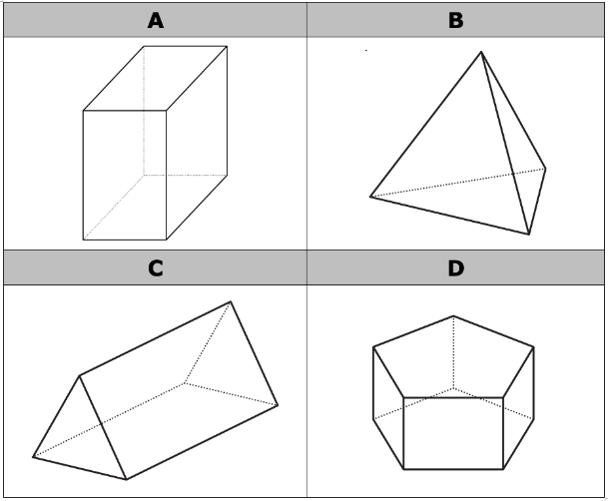
8.5.1 Warm-Up: Which One Doesn’t Belong?
Four figures are shown.
Which one doesn’t belong?
Justify your choice using mathematics.
volume 2, pg. 25

Slide 7

Guided Instruction
volume 2, pg. 25

Slide 8
8.5.2 Guided Instruction: Surface Area of a Rectangular Prism
To find the surface area of a three-dimensional object, use the nets of a shape to find the area of each face.
Surface area is the total area of the two-dimensional surfaces that make up a three-dimensional object
volume 2, pg. 25

Slide 9
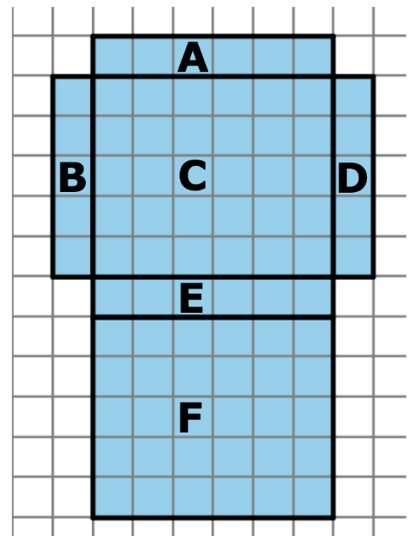
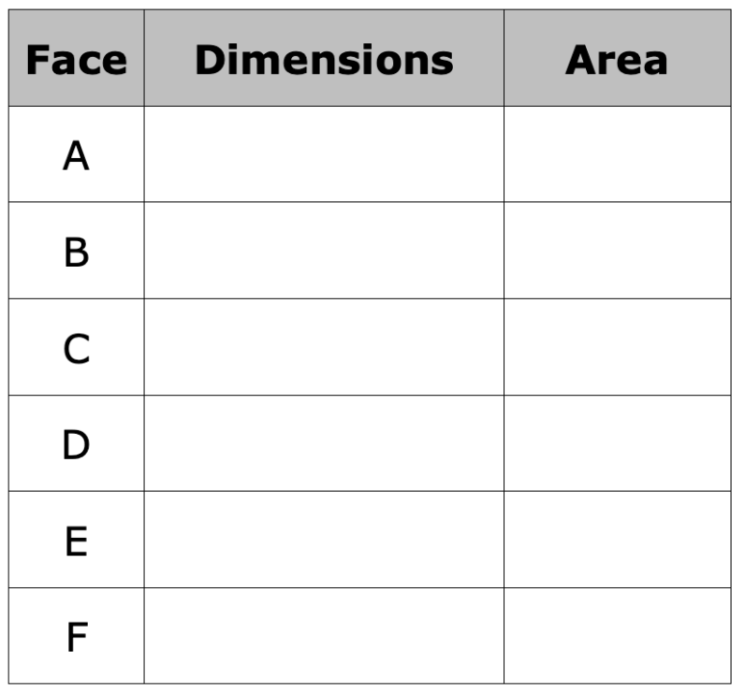
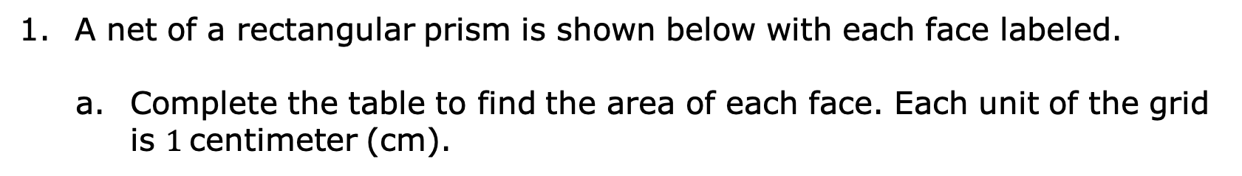
A net of a rectangular prism is shown below with each face labeled.
Complete the table to find the area of each face. Each unit of the grid is $1$ centimeter (cm).
volume 2, pg. 25

Slide 10

How can the net and the area of the six faces be used to find the surface area of the prism?
What is the surface area of this rectangular prism?
When calculating surface area, find the sum of the areas of each face of the figure. Use the figure’s net to label the dimensions needed to calculate the area of each face.
volume 2, pg. 26

Slide 11


A tissue box is $9$ inches (in.) long, $5$ in. wide, and $6$ in. tall.
Sketch the net of the tissue box.
Label the dimensions of each face on the net.
volume 2, pg. 26

Slide 12
Find the area of each face. Include units.
Add the area of the faces to find the surface area of the tissue box. Include units.
volume 2, pg. 27

Slide 13

Collaboration
volume 2, pg. 27

Slide 14

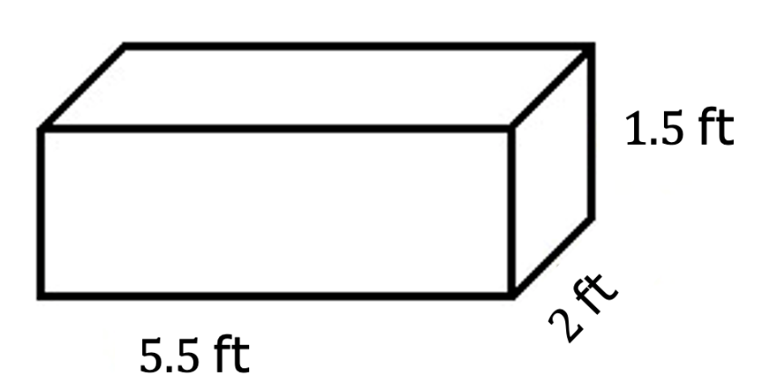
8.5.3 Collaboration: Analyzing Student Work
Jillian and Victor are finding the surface area, in square feet (ft²), of the rectangular prism shown and each got the same answer; however, they solved the problem differently.
volume 2, pg. 27

Slide 15
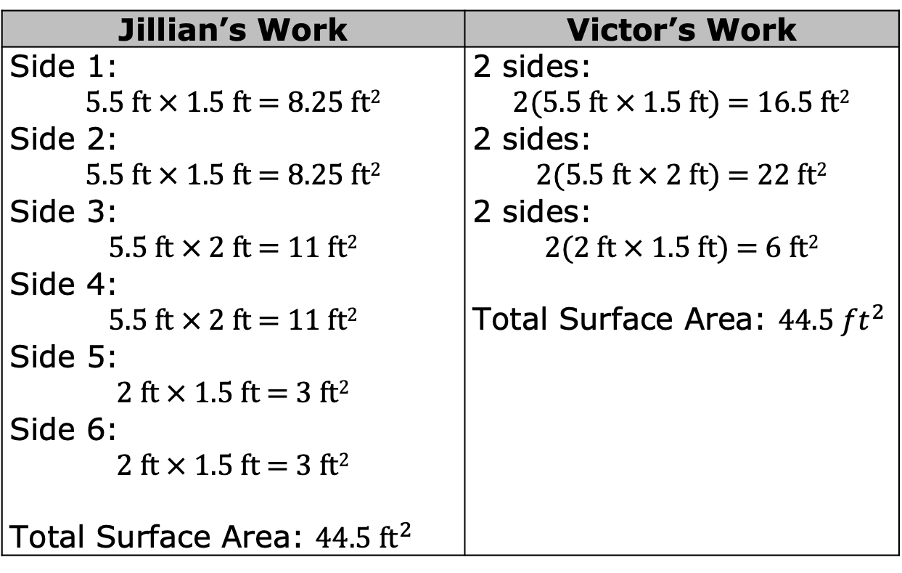
Discuss with your partner each student’s strategy and how they are similar or different. Draw arrows to show connections between each student’s work.
Jillian’s Work | Victor’s Work
Side 1: $5.5$ ft $×$ $1.5$ ft $=$ $8.25$ ft² Side 2: $5.5$ ft $×$ $1.5$ ft $=$ $8.25$ ft² Side 3: $5.5$ ft $×$ $2$ ft $=$ $11$ ft² Side 4: $5.5$ ft $×$ $2$ ft $=$ $11$ ft² Side 5: $2$ ft $×$ $1.5$ ft $=$ $3$ ft² Side 6: $2$ ft $×$ $1.5$ ft $=$ $3$ ft² Total Surface Area: $44.5 {\text{ft}}^{2}$ | 2 sides: $2$($5.5$ ft $×$ $1.5$ ft) $=$ $16.5$ ft² 2 sides: $2$($5.5$ ft $×$ $2$ ft) $=$ $22$ ft² 2 sides: $2$($2$ ft $×$ $1.5$ ft) $=$ $6$ ft² Total Surface Area: $44.5 {ft}^{2}$
volume 2, pg. 27

Slide 16
Guided Instruction
volume 2, pg. 28

Slide 17
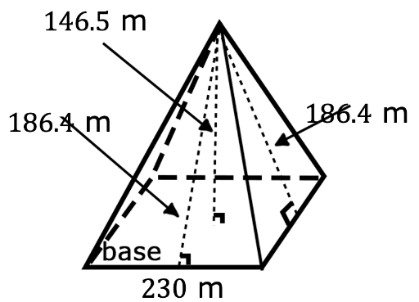
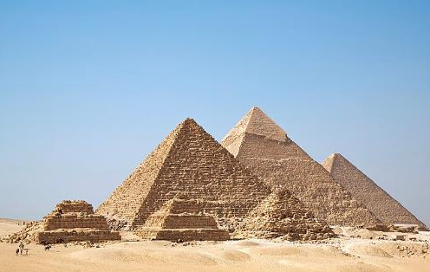
8.5.4 Guided Instruction: Surface Area of a Rectangular Pyramid
Around 2500 B.C. the Egyptians began building pyramids with intricate hallways and layouts to house the tombs of pharaohs and their families. One of the most famous is the Great Pyramid of Giza, also known as the Pyramid of Khufu, seen below. The Egyptians designed the pyramid to have a square base with approximate side lengths of 230 meters, a height of 146.5 meters, and a slant height of 186.4 meters.
volume 2, pg. 28

Slide 18

Looking at the model of the pyramid, why is there a measurement called height and a measurement called slant height?
The slant height of the pyramid represents the height of each triangular face.
When finding the surface area of a pyramid, use the slant height to find the area of the faces.
volume 2, pg. 28

Slide 19
Using the information about the pyramid, complete the table to determine the surface area of the pyramid. Begin by labeling the sides of the net.
volume 2, pg. 28

Slide 20
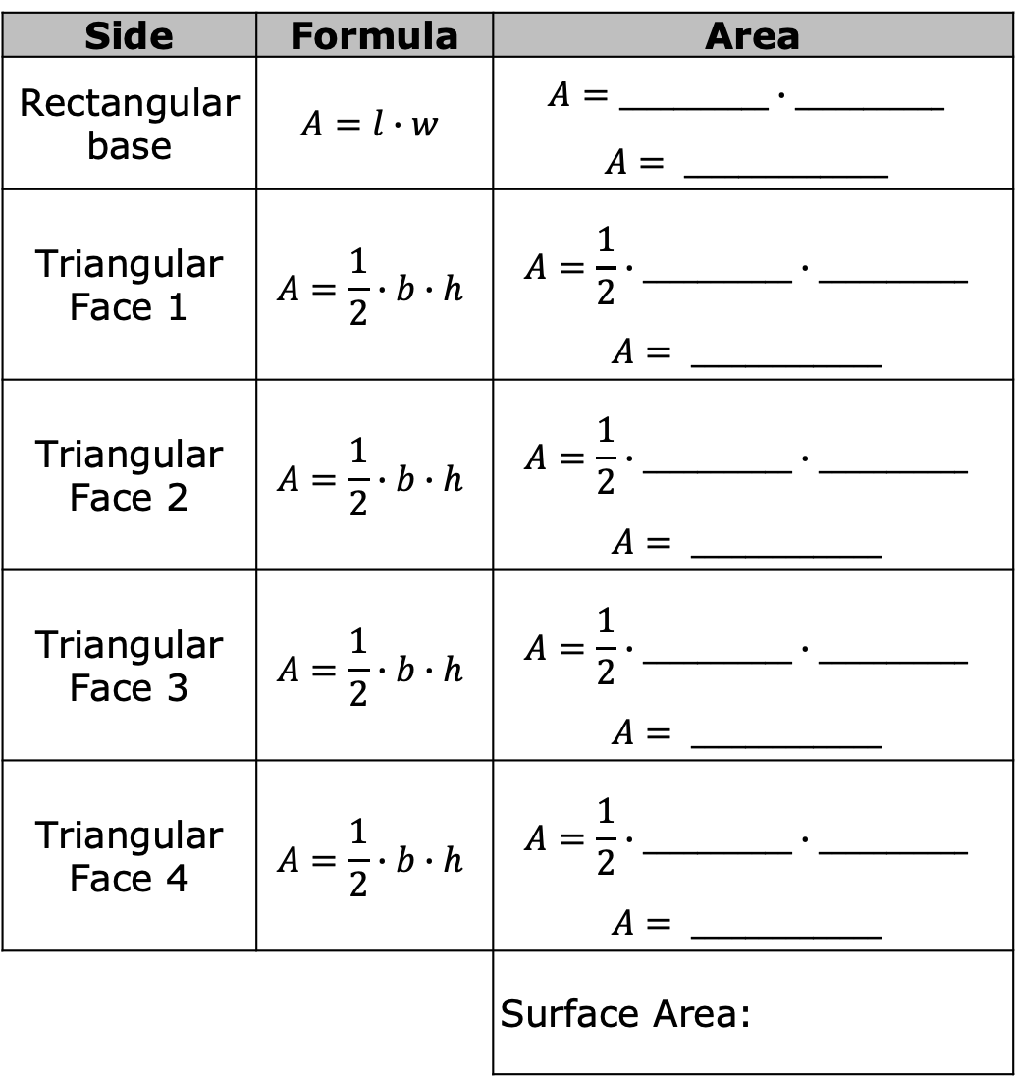
Side | Formula | Area
Rectangular base | $$A=l∙w$$ | $$A=___________∙___________$$ $$A= _______________$$
Triangular Face 1 | $$A=\frac{1}{2}∙b∙h$$ | $$A=\frac{1}{2}∙___________∙___________$$ $$A= ______________$$
Triangular Face 2 | $$A=\frac{1}{2}∙b∙h$$ | $$A=\frac{1}{2}∙___________∙___________$$ $$A= ______________$$
Triangular Face 3 | $$A=\frac{1}{2}∙b∙h$$ | $$A=\frac{1}{2}∙___________∙___________$$ $$A= ______________$$
Triangular Face 4 | $$A=\frac{1}{2}∙b∙h$$ | $$A=\frac{1}{2}∙___________∙___________$$ $$A= ______________$$
 |  | Surface Area:
volume 2, pg. 28

Slide 21
Complete the following statement.
To find the surface area of a rectangular pyramid you need
the sum of the of the base plus the area of
the other faces.
height
area
one of
all
volume 2, pg. 29

Slide 22
Collaboration
volume 2, pg. 29

Slide 23
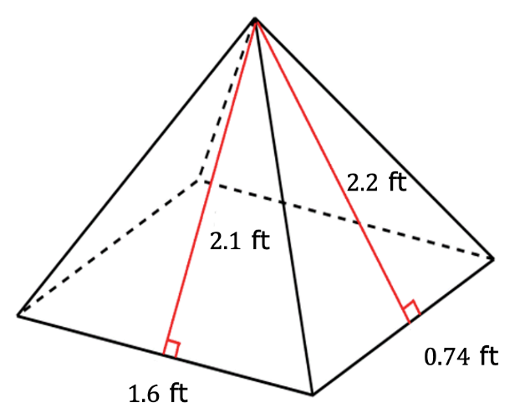
8.5.5 Collaboration: Surface Area of a Rectangular Pyramid
Papier-mache is a type of art that uses paper and glue. Jose is using the art of papier-mache to create a rectangular pyramid for his art project. To create his project, Jose needs to determine the amount of area that will be covered in newspaper. Below is the drawing Jose created to find the surface area.
Work with your partner to find the surface area of the pyramid.
volume 2, pg. 29

Slide 24

Your Turn
volume 2, pg. 30

Slide 25
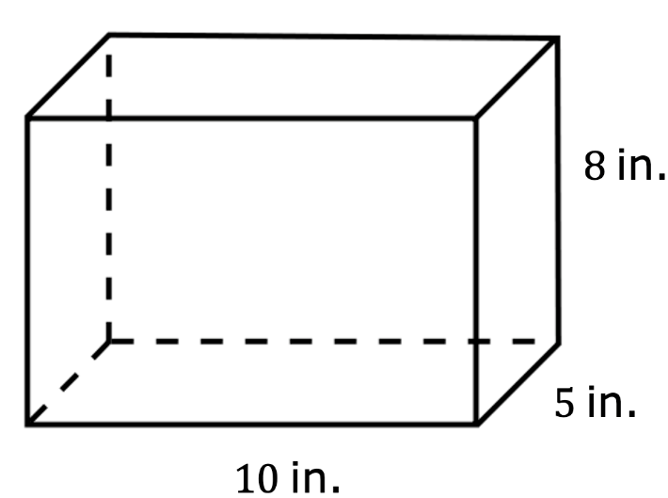
8.5.6 Your Turn!
Darsey wants to build trinket boxes made of wood to sell at the local craft festival. A drawing of her box is shown. How much wood does Darsey need to buy for each trinket box?
volume 2, pg. 30

Slide 26
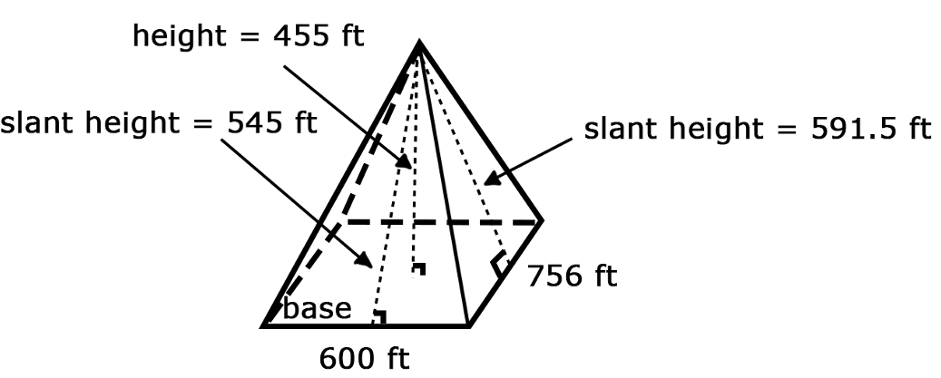
Find the surface area of a rectangular pyramid that has a rectangular base with a side length of 600 feet (ft), which is the base of the triangle with a slant height of 545 ft, and a side length of 756 ft, which is the base of the triangle with a slant height of 591.5 ft.
volume 2, pg. 30

Slide 27

Wrap-Up
volume 2, pg. 31

Slide 28
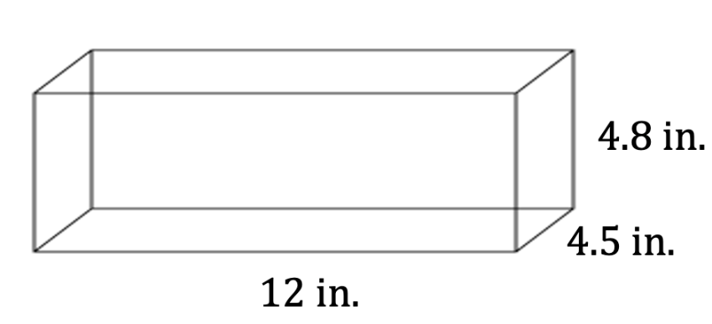
8.5.7 Wrap-Up: Ticket Out the Door
Ted is preparing a holiday display for the post office. He takes an unfolded box and uses it to determine the amount of wrapping paper needed to wrap the box.
The shipping box Ted uses for the display is shown.
volume 2, pg. 31

Slide 29

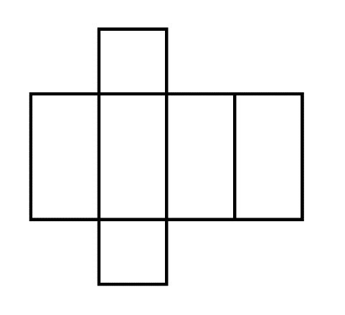
Write the measurements on the net of the box.
Use the net to find the surface area of the shipping box. Include units.
volume 2, pg. 31

